Slide 1
A Hybrid Hardware Architecture for High-Speed IP
Lookups and Fast Route Updates
Author :Layong Luo, Gaogang Xie, Yingke Xie, Laurent Mathy
Publisher: IEEE/ACM TRANSACTIONS ON NETWORKING

Slide 2
Finding solutions that achieve both fast lookup and low update overhead

Slide 3
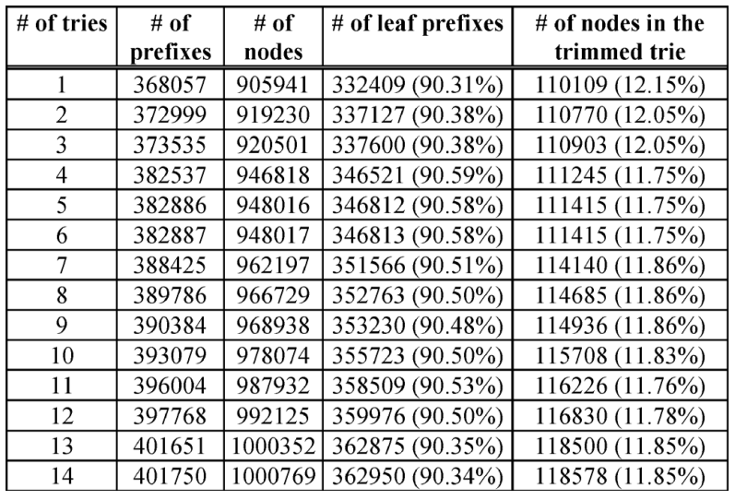

Slide 4
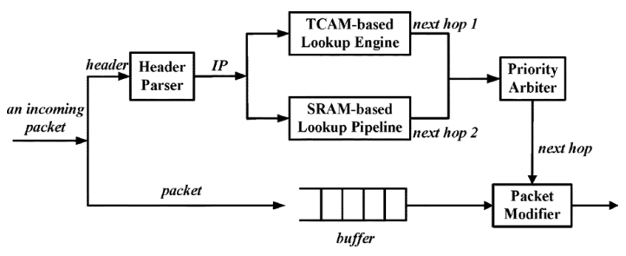
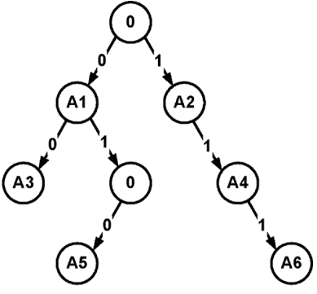
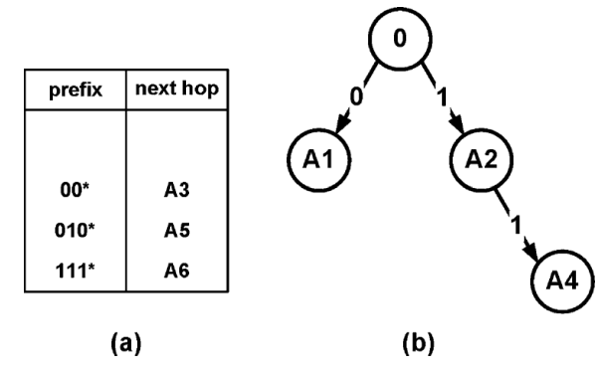

Slide 5
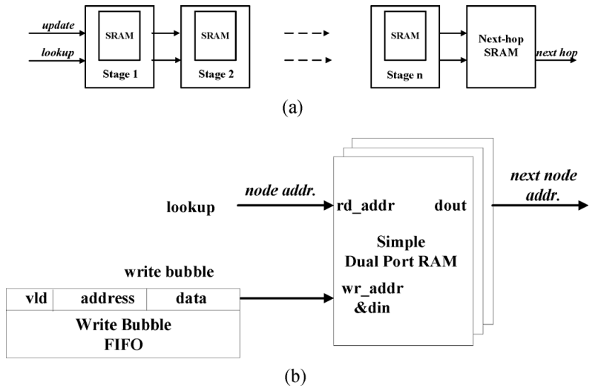

Slide 6
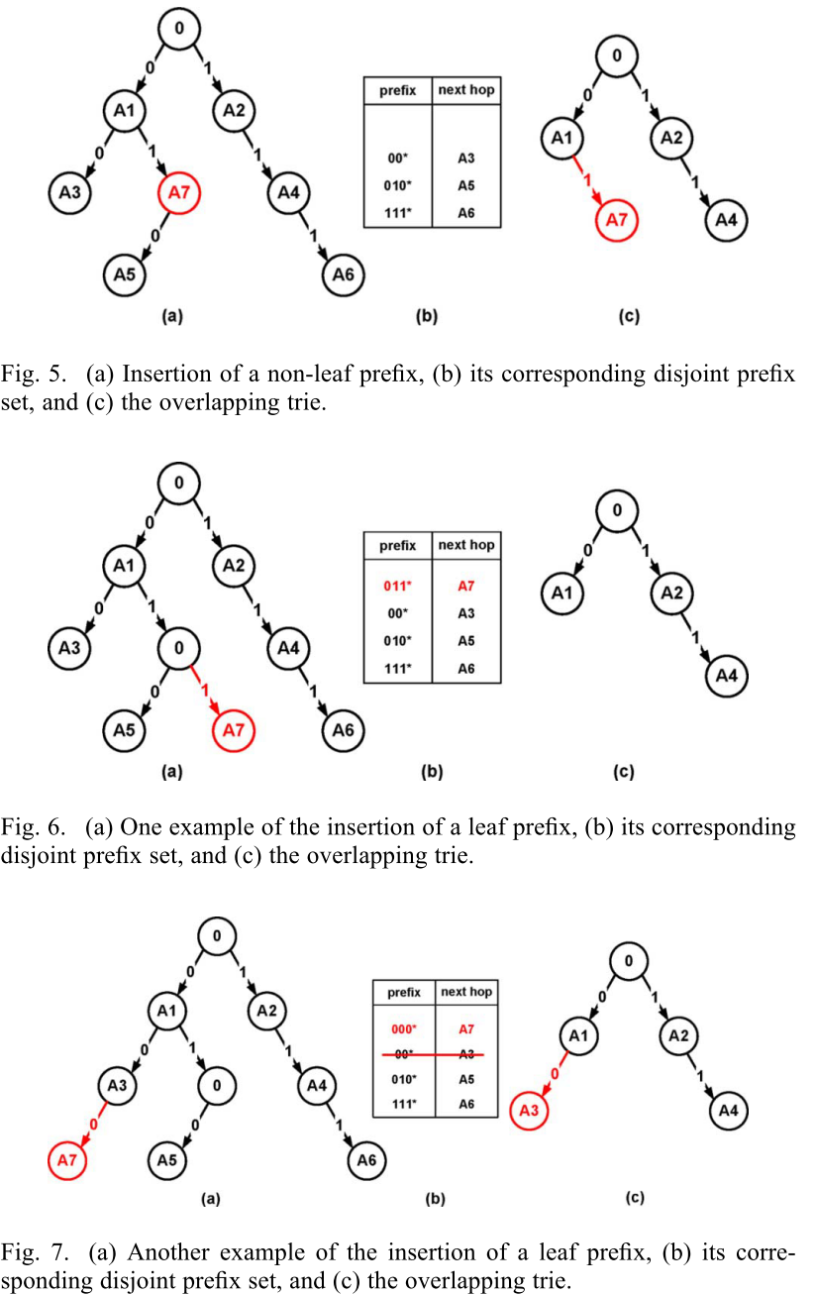

Slide 7
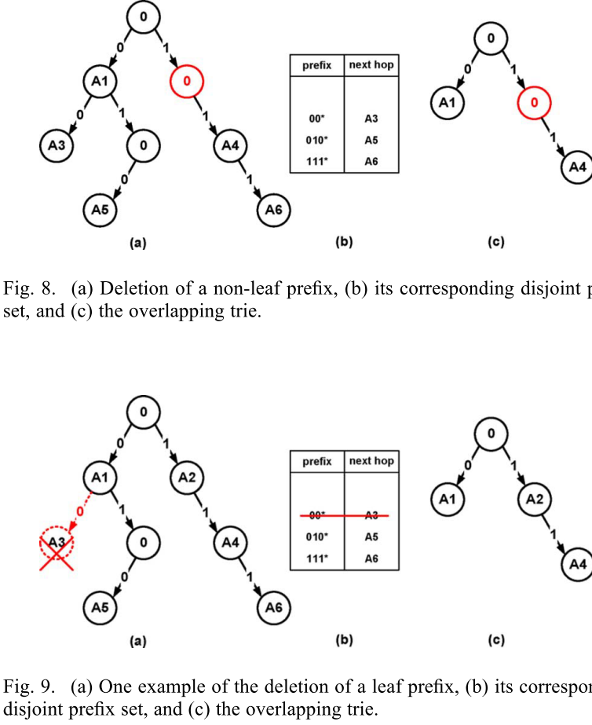
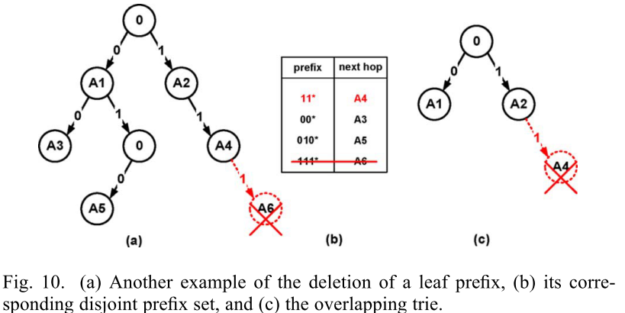

Slide 8
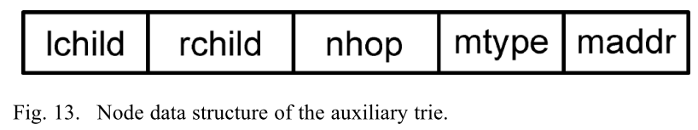
Each node contains ﬁve ﬁelds,
left child pointer (lchild),
right child pointer(rchild),
next-hop pointer (nhop),
memory type (mtype),
memory address (maddr).

Slide 9
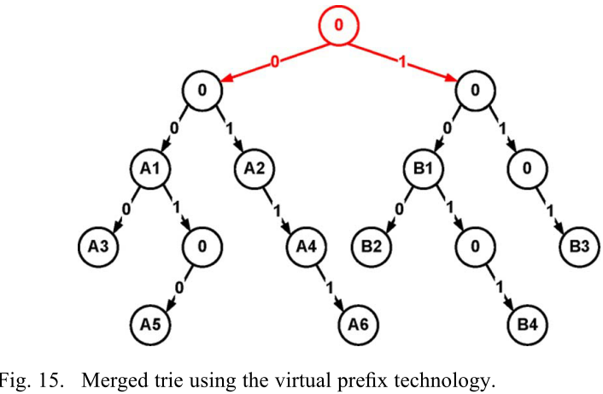

Slide 10
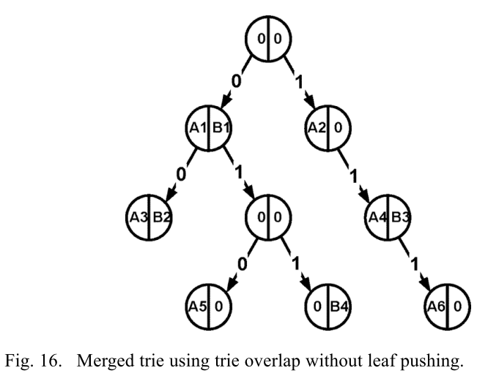
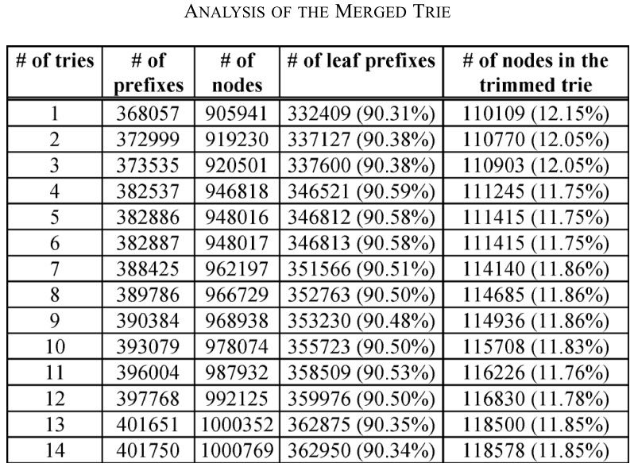

Slide 11
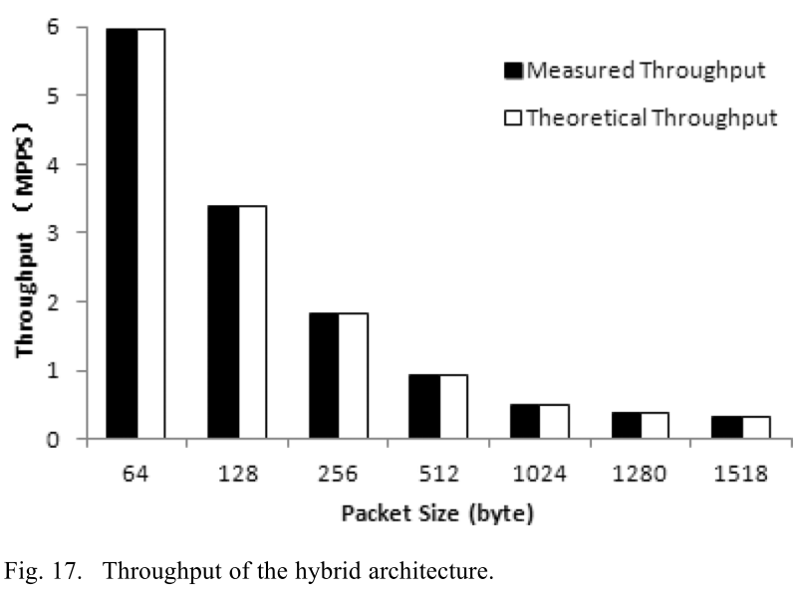

Slide 12
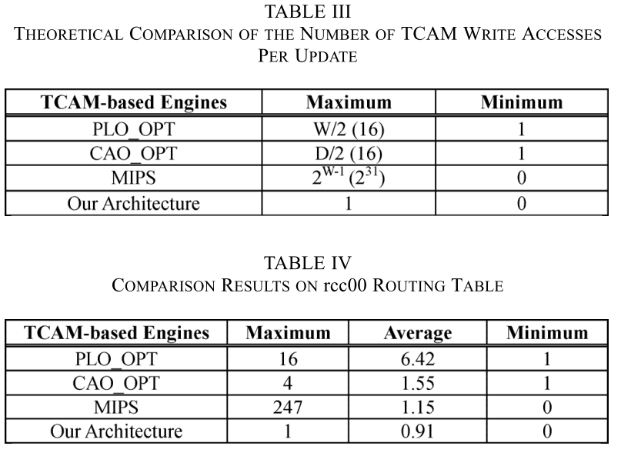

Slide 13
